Slide 1

Chapter 1
Introduction

Slide 2
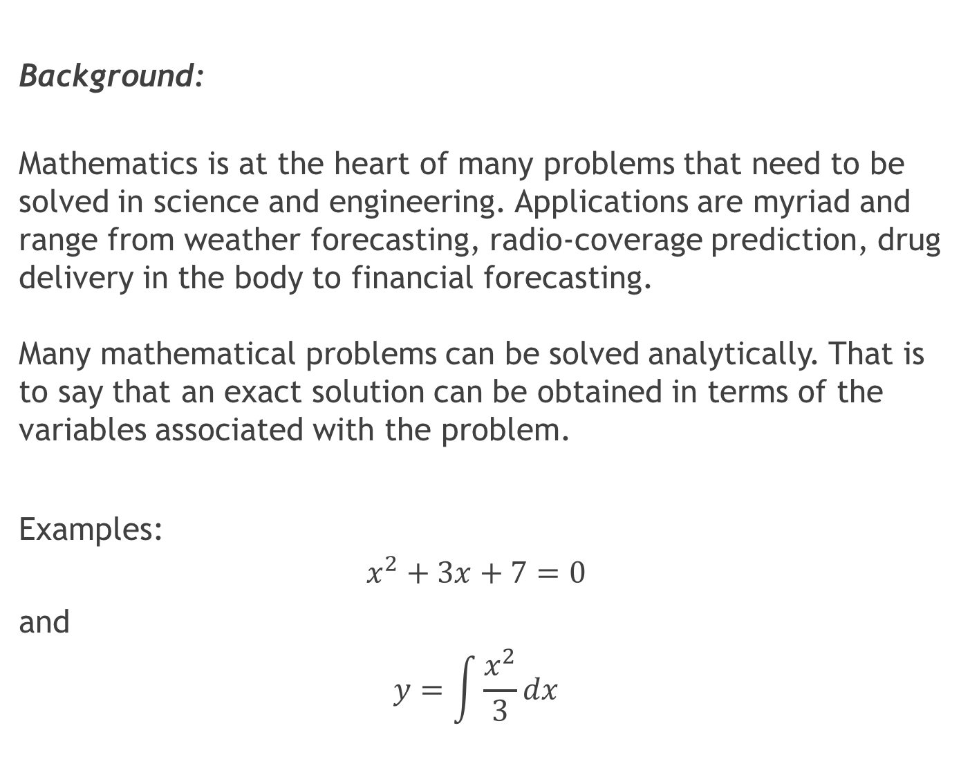
Background:
Mathematics is at the heart of many problems that need to be solved in science and engineering. Applications are myriad and range from weather forecasting, radio-coverage prediction, drug delivery in the body to financial forecasting. Many mathematical problems can be solved analytically. That is to say that an exact solution can be obtained in terms of the variables associated with the problem.
Examples:
$$x^{2}+3x+7=0$$
and
$$y=\int{\frac{x^{2}}{3}}dx$$

Slide 3
Background:
A numerical solution to the problem is performed where the problem cannot be solved analytically or where the number of operations required are too excessive to be done by hand.
A numerical solution is usually approximate to within a specified interval.

Slide 4
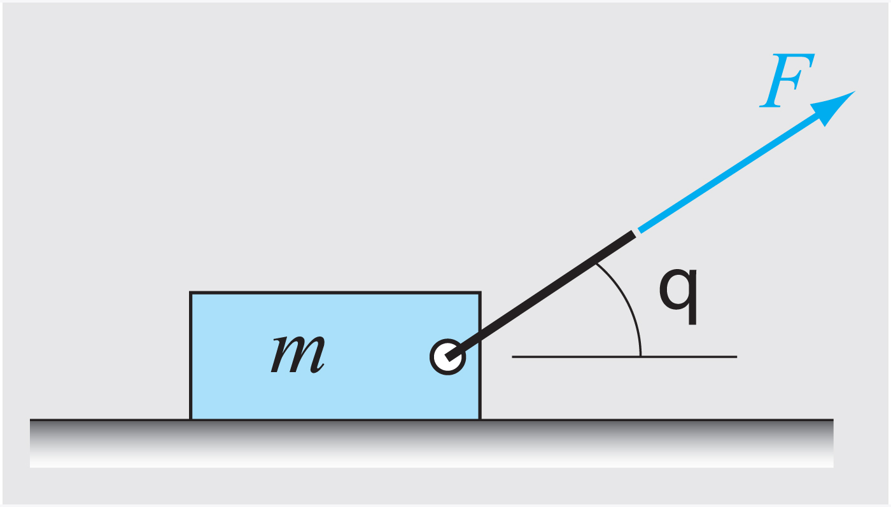
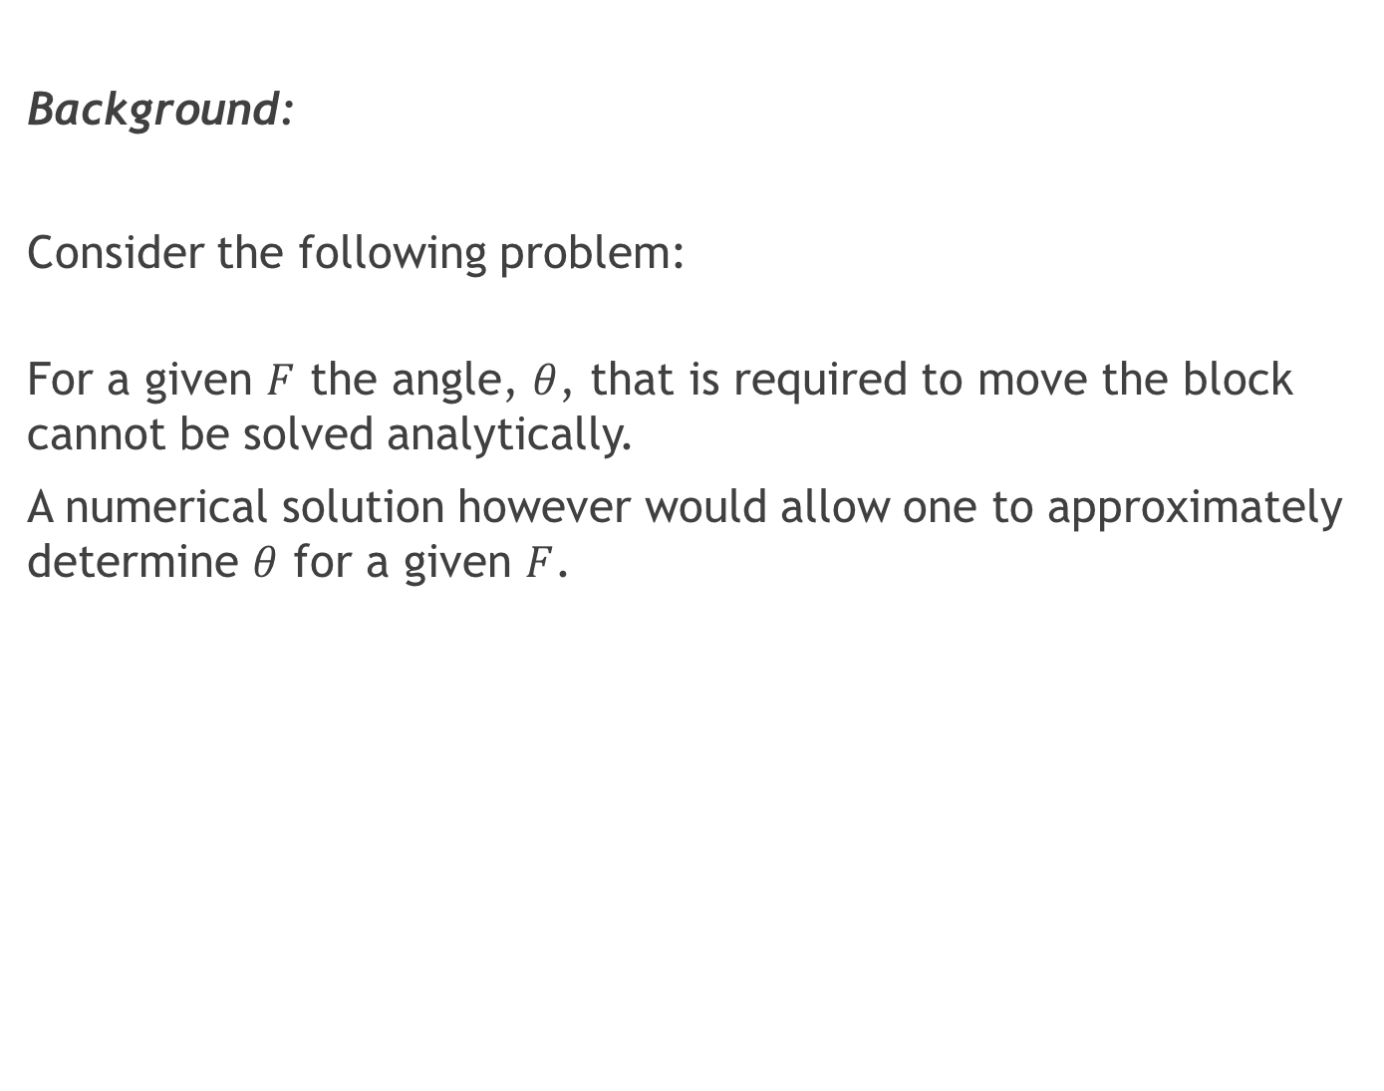
Background:
Consider the following problem:
For a given $F$ the angle, $θ$, that is required to move the block cannot be solved analytically.
A numerical solution however would allow one to approximately determine $θ$ for a given $F$.

Slide 5
